Slide 1
EH - Buffer Overflow Lab
In this presentation, we will explore the solutions developed during ethical hacking labs, focusing on leveraging buffer overflow vulnerabilities. These exercises demonstrate practical techniques for identifying, exploiting, and mitigating such vulnerabilities, providing valuable insights into secure coding and system defense strategies.
Edited by
Denis Gasparollo 2104298
Andrea Signori 2131195

Slide 2
Index
Task 1: Get Familiar with the Shellcode
Task 2: Level-1 Attack
Task 3: Level-2 Attack
Task 4: Level-3 Attack
Task 5: Level-4 Attack
Task 6: Experimenting with the Address Randomization
Task 7: Experimenting with Other Countermeasures
Extra: Buffer overflow in ARM architecture

Slide 3
Task 1: Get Familiar with the Shellcode

Slide 4
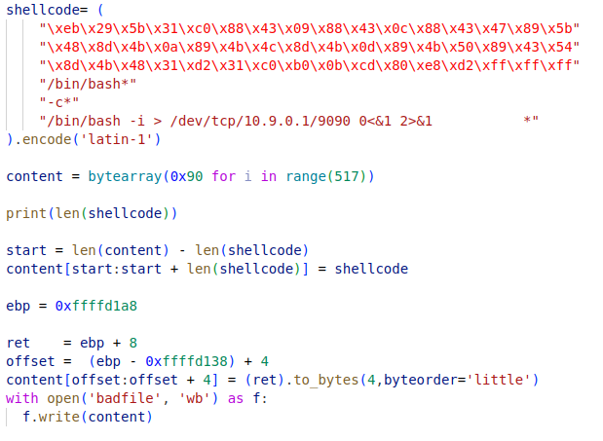

Task 1: Get Familiar with the Shellcode

Slide 5
Task 2: Level-1 Attack

Slide 6
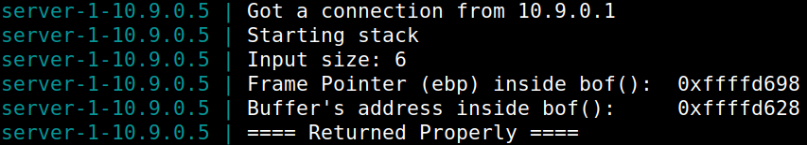
Task 2: Level-1 Attack
32 bit addresses;
ebp and esp are known => buffer dimension is known;
Goal: get a root shell for the victim

Slide 7
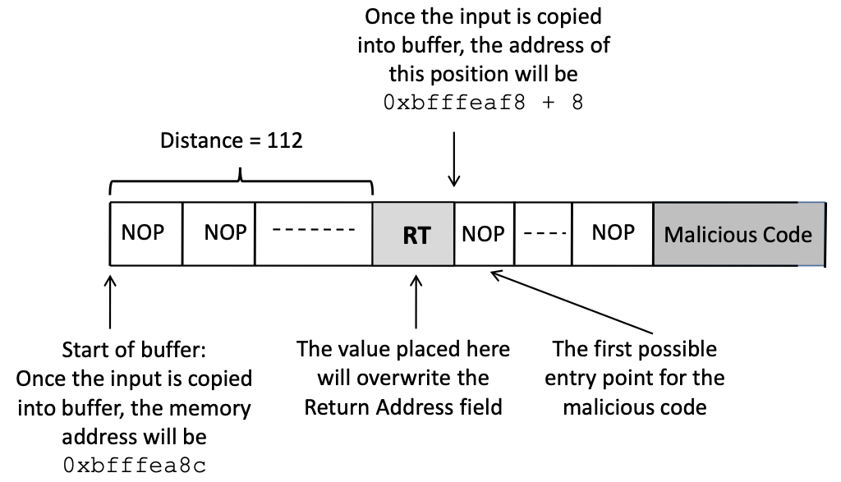
Task 2: Level-1 Attack
The badfile structure is the following

Slide 8
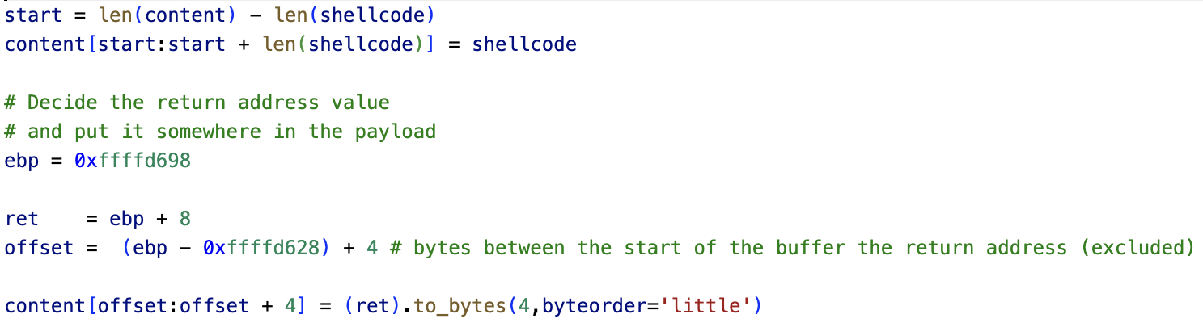
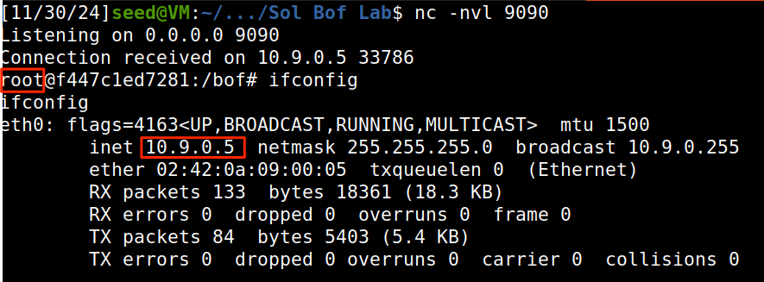
Task 2: Level-1 Attack

Slide 9
Task 3: Level-2 Attack

Slide 10

Task 3: Level-2 Attack
32 bit addresses;
esp is known;
ebp and buffer dimension are not know (Range 100-300B);
Goal: get a root shell for the victim

Slide 11
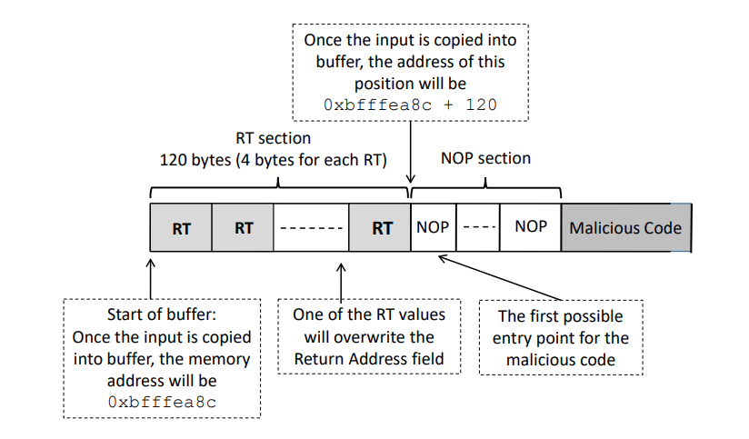
Task 3: Level-2 Attack

Slide 12
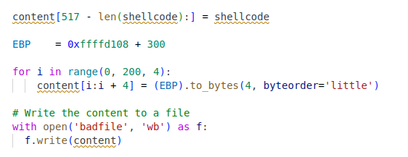
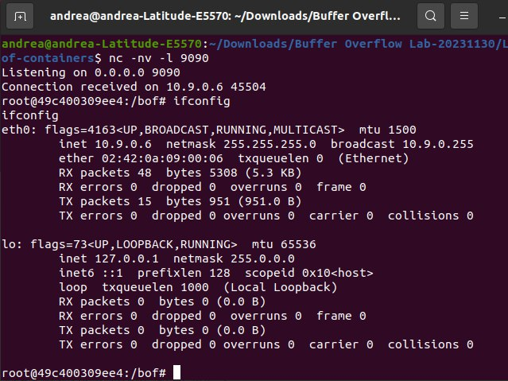
Task 3: Level-2 Attack

Slide 13
Task 4: Level-3 Attack

Slide 14
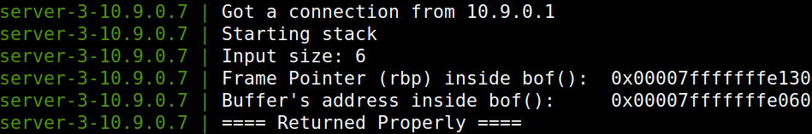
Task 4: Level-3 Attack
64 bit addresses => strcpy() gives a problem with the highest 2 bytes which are always zero;
rbp and esp are known => buffer dimension is known
Goal: get a root shell for the victim

Slide 15
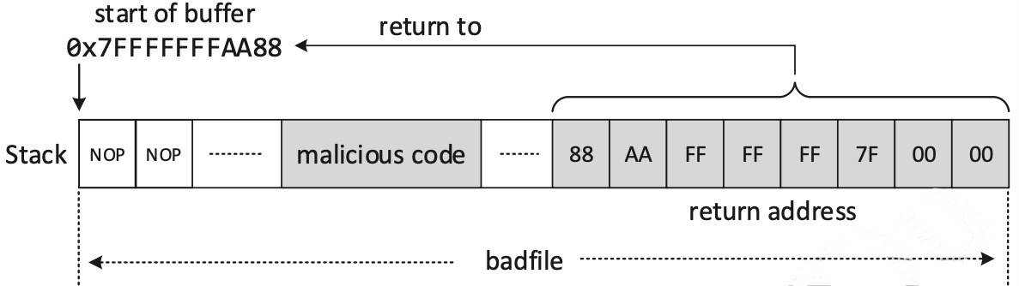
Task 4: Level-3 Attack
The badfile structure is the following

Slide 16
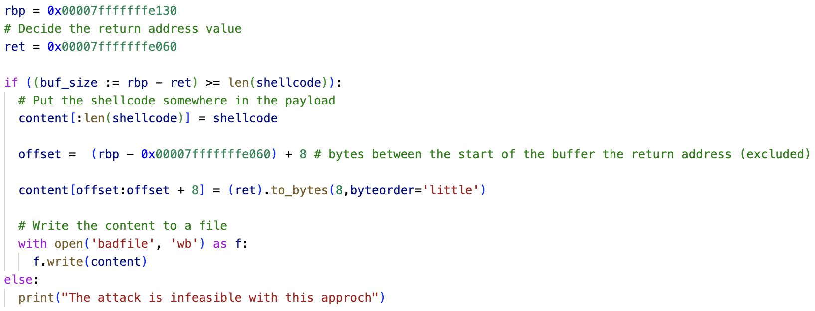
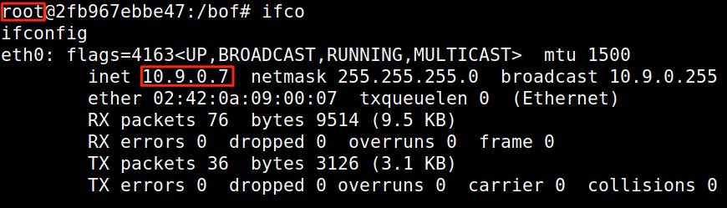
Task 4: Level-3 Attack

Slide 17
Task 5: Level-4 Attack

Slide 18
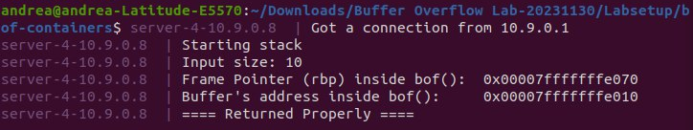
Task 5: Level-4 Attack
64 bit addresses => strcpy() gives a problem with the highest 2 bytes which are always zero;
rbp and esp are known => buffer dimension is known but NOT ENOUGH
Goal: get a root shell for the victim

Slide 19
Task 5: Level-4 Attack
int foo(char *str){
char buffer[10];
strcpy(buffer, str);
return 1;
}
int main(int argc, char **argv){
char str[400];
FILE *badfile;
badfile = fopen("badfile", "r");
fread(str, sizeof(char), 400, badfile);
foo(*str);
}
int dummy(char *str){
char dummy[1000]
foo(str)
}

Slide 20
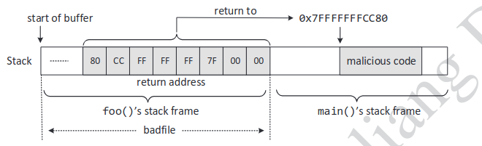
Task 5: Level-4 Attack

Slide 21
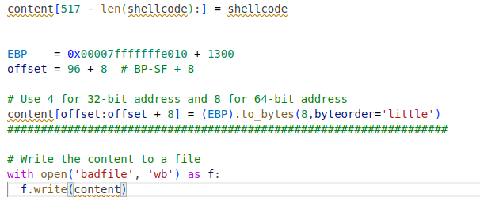
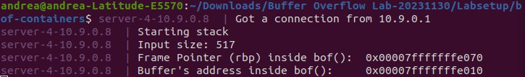
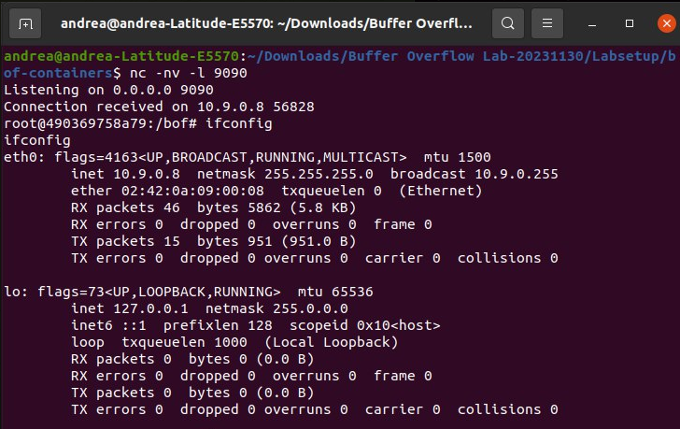
Task 5: Level-4 Attack

Slide 22
Task 6: Experimenting with the Address Randomization

Slide 23
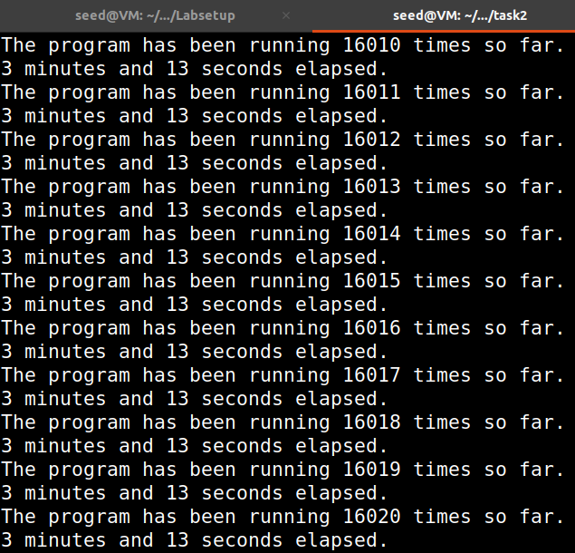
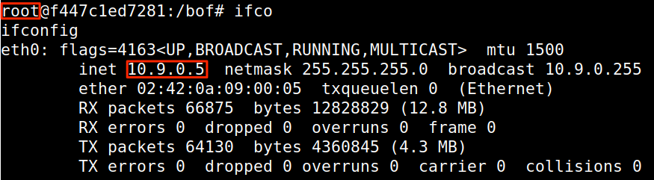
Task 6: Experimenting with the Address Randomization
Through the following command we enable ASLR (previously disable)
sudo /sbin/sysctl -w kernel.randomize_va_space=2
Only way to succeed with a buffer overflow attack is to use a brute force approach until the addresses in the payload are correct
We use the same payload saw in the Task 2
The payload is launched by a shell script that perform the brute-force (describe above).It gets from the lab instruction.

Slide 24
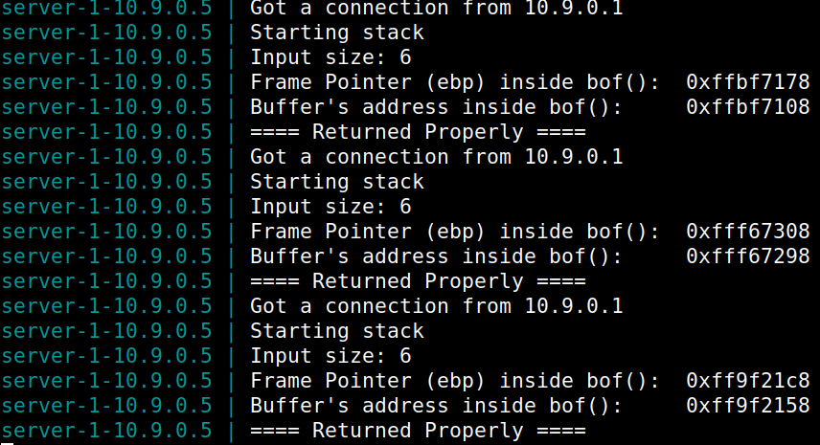
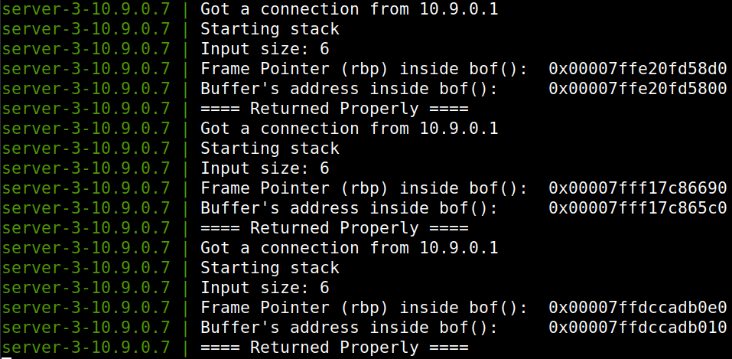
Task 6: Experimenting with the Address Randomization
Randomizing the memory address is a valuable countermeasure against buffer overflow especially in 64 bit machine. As we can see in the previous slide, despite the fact that our address changes every execution, in 32 bit machine it require a reasonable amount of time to succeeding with this attack using brute force

Slide 25
Task 7.a: Turn on the StackGuard

Slide 26

Task 7.a: Turn on the StackGuard
gcc -DBUF_SIZE=100 -o stack -z execstack -static -m32 stack.c

Slide 27
Task 7.b: Turn on the Non-executable Stack Protection

Slide 28
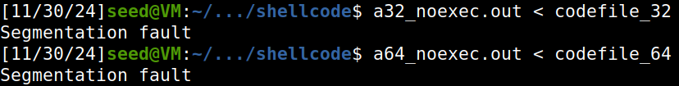
Task 7.b: Turn on the Non-executable Stack Protection
See what’s happen to buffer overflow attack if we have a non executable stack;
-z noexecstack flag during the compilation:
gcc -m32 -z noexecstack -o a32_noexec.out call_shellcode.c
gcc -z noexecstack -o a64_noexec.out call_shellcode.c
create a payload with a python script provided
Segmentation fault is caused by the fact that the overwritten return address point to a memory location in the stack, where the program has not the permission to execute.

Slide 29
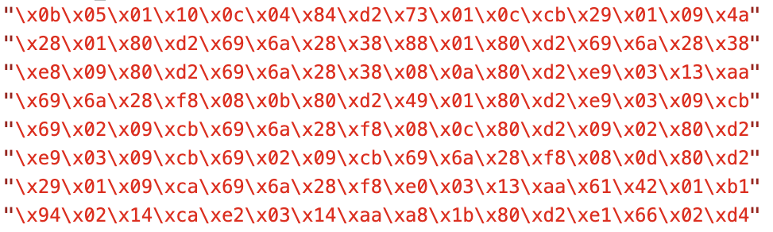
Extra: Buffer overflow in ARM architecture
The general approach still the same except for the following things:
work only with 64 bit addresses;
NOP instruction change (0xD503201F);
different shellcode
rbp register is called x29.

Slide 30
The END
Source code + Presentation available at:
https://github.com/AndreaSignori/EthicalHacking---Buffer-Overflow-Lab-24-25

